Slide 1
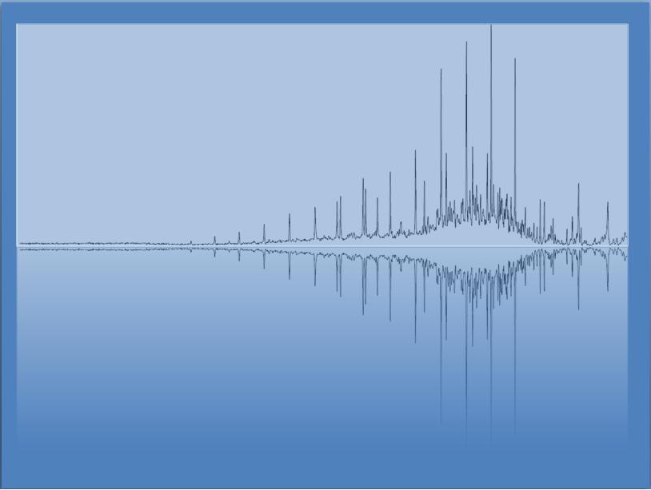
Welcome to Day 1!
Chem 3A- Yates

Slide 2
Outline
Demo & Introduction to Class Plan
Measurements, Precision, Significant Figures
Scientific Notation
Density
Unit Conversions

Slide 3
Learning Communities
One of, if not THE, most important factors in student success in College.
Groups of people working together toward a shared goal.
Your Learning Community will likely include
Faculty
Students (Peers)
Tutors
Counselors
Other College Staff

Slide 4
I’m hoping I can convince you that…
Reaching out to me, tutors, study group members, etc. when you need help understanding a concept (which you will), is not an option if you want to succeed.
I’ve structured the class to make many of these things required, so as not to give you the impression that they are optional.
*I may allow small adjustment to some of these requirements in specific cases, but only if you show me that you are doing what’s necessary to succeed.

Slide 5
Why?
Because I want you all to be successful!

Slide 6
Support Options
Office Hours
Tu: 2:30 – 3:20 am (NS-301)
Fri 8:00 – 10:50 am (GRASP, Location TBD)
GRASP (Faculty-Led Tutoring)
8:00 am – 2:00 pm, Every Friday
Location: TBD
Tutorial Center (Link to hours on Canvas)
Your Study Group
…

Slide 7
Study Groups
We will get to know each other in lab this week.
You can text each other reminders about due dates, etc.
Reach out when you’re struggling (AI can be great, but we all still need human community- they complement each other, not replace.)
Meet together to work on problems and discuss strategies.

Slide 8
Outline
Stories & Introduction to Class Plan
Measurements, Precision, Significant Figures
Scientific Notation
Density
Unit Conversions

Slide 9
Significant Figures
Bathroom Scale vs Lab Balance Example
(Dealing with measurement precision in
addition and subtraction)

Slide 10
Rounding Answers from Calculations
Addition/Subtraction
Round to the same place as the least precise measurement.
Multiplication/Division
Round to the same # of significant figures as least # of significant figures in problem.

Slide 11
Counting Significant Figures
All non-zero digits are significant.
“Sandwiched” zeros are significant.
1.05 has 3 significant figures.
Trailing zeros after a decimal point are significant.
1.050 has 4 significant figures.
Leading zeros are NOT significant.
0.001050 has 4 significant figures.
Trailing zeros before a decimal point
are significant if decimal is shown 120. 3 s.f.
are not significant if decimal is not shown 120 2 s.f.

Slide 12
Determine the Number of Sig Figs
0.0035 m
1.080 g
2371 L
1 dozen = 12

Slide 13
Determine the Number of Sig Figs
0.0035 m 2 significant figures—leading zeros are not significant.
1.080 g 4 significant figures—trailing and interior zeros are significant.
2371 L 4 significant figures—All digits are significant.
1 dozen = 12 Unlimited significant figures—Definition

Slide 14
Rounding Answers from Calculations
Addition/Subtraction
Round to the same place as the least precise measurement.
Multiplication/Division
Round to the same # of significant figures as least # of significant figures in problem.

Slide 15
Example Problems
35.45 mL – 30.5 mL =
103.37 g/20.5 mL

Slide 16
Example Problem Answers
35.45 mL – 30.5 mL = 4.95 mL = 5.0 mL
103.37 g/20.5 mL = 5.042439 g/mL = 5.04 g/mL

Slide 17
Outline
Stories & Introduction to Class Plan
Measurements, Precision, Significant Figures
Scientific Notation
Density
Unit Conversions

Slide 18
Scientific Notation (Do on board)
Key- Remember that:
Large exponents are for numbers bigger than 1
500 = 5 x 10²
Small exponents are for numbers smaller than 1
0.005 = 5 x 10⁻³

Slide 19
Outline
Stories & Introduction to Class Plan
Measurements, Precision, Significant Figures
Scientific Notation
Density
Unit Conversions

Slide 20
Density
Done in lab ☺

Slide 21
Outline
Stories & Introduction to Class Plan
Measurements, Precision, Significant Figures
Scientific Notation
Density
Unit Conversions

Slide 22
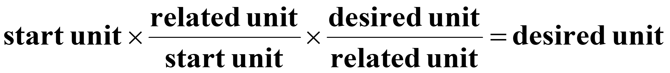
Unit Conv./Dimensional Analysis
Conversion factors are relationships between two units, generated from equivalence statements.
e.g., 1 inch = 2.54 cm
Arrange conversion factors so the starting unit cancels.

Slide 23
Common Prefixes in the SI System
Prefix | Symbol | Decimal Equivalent | Power of 10
mega- | M | 1,000,000 | Base x 10⁶
kilo- | k | 1,000 | Base x 10³
centi- | c | 0.01 | Base x 10⁻²
milli- | m | 0.001 | Base x 10⁻³
micro- | μ | 0.000 001 | Base x 10⁻⁶
nano- | n | 0.000 000 001 | Base x 10⁻⁹
*The prefixes in blue must be memorized.

Slide 24
Example
Convert 3.2 gallons to milliliters (mL)
Step 1: Write starting number and unit on left and desired on right.
Step 2: look up conversions involving gallons and mL. (For now, write them separately first.)
Step 3: Put the conversions into the problem in steps so that the starting unit cancels and you end up with the final unit you want.

Slide 25
Do In-Class Worksheet

Slide 26
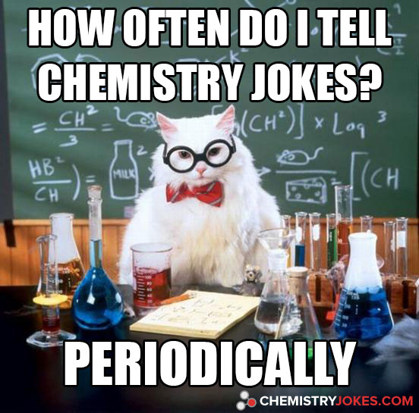
Chemistry Joke

